Slide 1
Introduction to Industrial Control System Security
An overview of functions, vulnerabilities, and security protocol implementations

Slide 2
Section 1:
System Overview of ICS

Slide 3
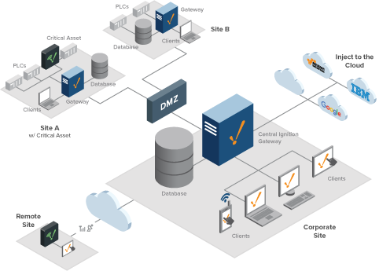
System Overview of ICS
What is an Industrial Control System?
Industrial Control Systems are systems that are made up of various devices, that use computational logic and mechanical controllers to facilitate the process function and execution within an industrial facility.
A few examples of system architectures include Supervisory Control and Data Acquisition systems (SCADA), or Distributed Control systems (DCS). These systems are not mutually exclusive.
Function dictates design of system
Notes:
Computational logic refers to act of using computers to establish facts in logical formalisms. It involves pattern recognition, decomposition, recognition, abstraction, and algorithms. The most commonly used ICS device used for computational logic is a PLC, but everything that includes any type of computing, is using computational logic.
For example, a chemical engineering lab that manufactures material products for use in laboratory settings is going to need different controls and devices than a plant that is using the natural flow of the river nearby for hydroelectric power production.

Slide 4
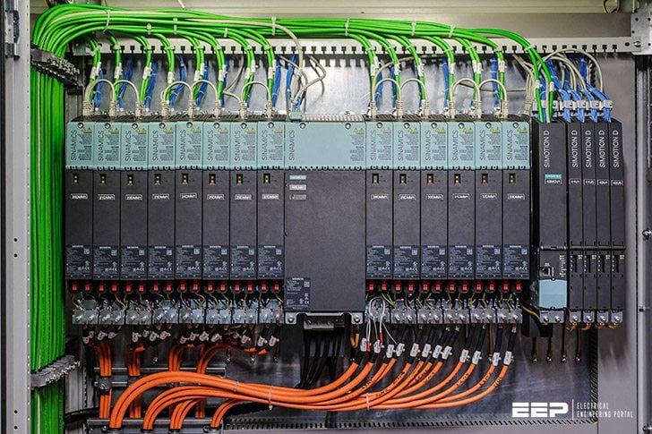
System Overview of ICS
What makes up and ICS?
ICS complexity depends on process complexity
These systems can include many different mechanical, analogue, or digital devices, they also include the network (if any) and any associated client machines (computers) that are needed to execute the process correctly and safely.
Some of these devices include :
PLCs (Programmable Logic Controllers)
Actuation Switches and Actuated Valves
Human Machine Interfaces (HMIs)
Measuring Instrumentation
Intelligent Electronic Devices (IEDs)
Data historians

Slide 5
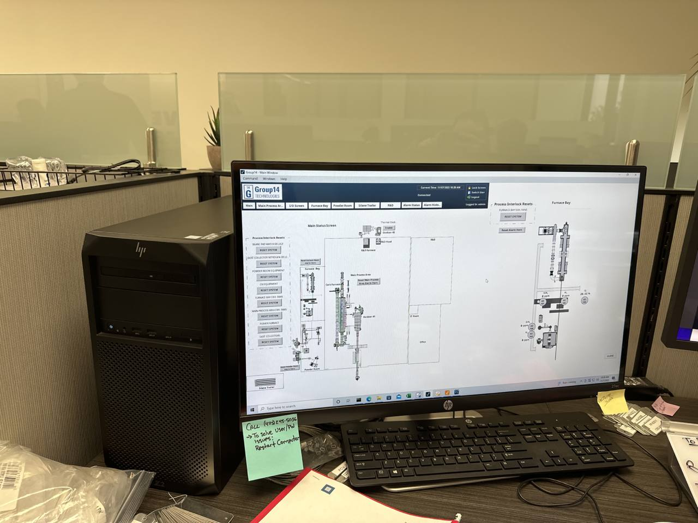
System Overview of ICS
What is SCADA architecture?
At the Group14 BAM 1 factory we use a SCADA architecture to facilitate process controls
SCADA architecture encompasses both low and high level control system devices, including sensors, computers, networked data communications, graphical user interfaces, and PLCs.
These are connected to the supervisory computer (Nate’s desk) which is used to control and monitor the plant floor’s Operational Network
The interfaces used by the operator(s) enable monitoring and invoke process commands. These high level commands mean that subordinate commands are performed automatically based on the command issued

Slide 6
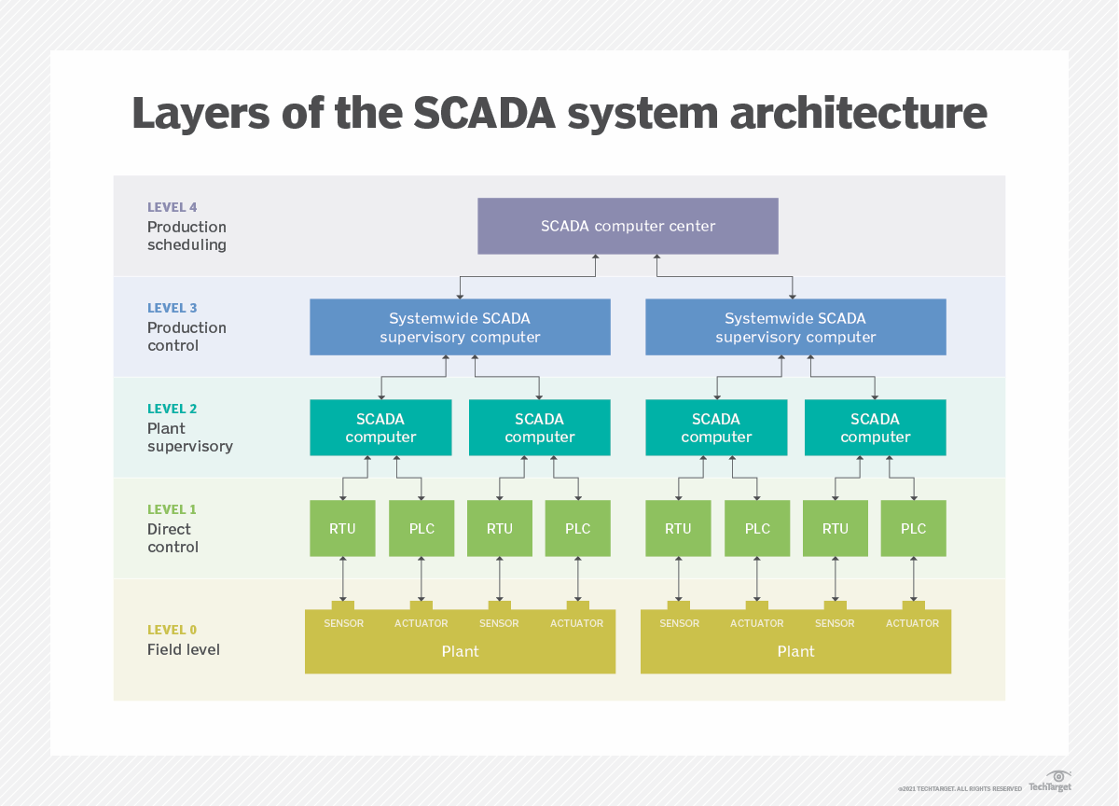
System Overview of ICS
Layers of SCADA architecture
SCADA architecture (cont.)
Level 0: Contains field devices and control elements (actuated devices)
Level 1: Contains industrialized I/O modules (Input/Output) and their associated processing units
Level 2: Contains Supervisory computers, which aggregate data and issue process commands
Level 3: Contains production controls, not directly tied to process control, but is concerned with monitoring process and product.
Level 4: Production scheduling level. In charge of facilitating timing and management of control processes on a human level

Slide 7
System Overview of ICS
What is DCS architecture?
A system architecture that uses a single controller at a central location to control commands in one specific loop of the process, and then takes those controllers and links them further upstream to some other unit (e.g supervisory, data historians, etc.)
Data acquisition functions and control functions are carried directly through DCS controllers, which are distributed in places where the parts of the process directly take place
Distributed individual automatic controllers are linked upstream to these hierarchical DCS controllers, operated by staff, and perform subordinate duties in compliance with the command executed.
This is the system architecture that will be used at the Moses Lake facility

Slide 8
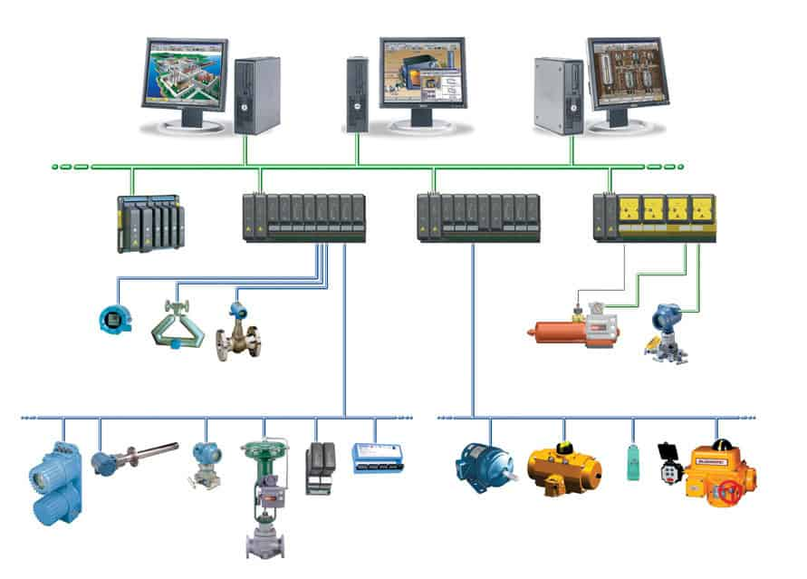
System Overview of ICS
DCS System Architecture
DCS architecture (cont.)
Low level device (illustrated by blue connection) control is sent upstream to a field bus which interfaces with the DCS controller specific to that geographic region
These DCS controllers are sent upstream (illustrated by green connection) to RTUs (Remote Terminal Units) for operators to execute controls using a graphical interface
These RTUs can then be sent upstream or sidestream to Supervisory Units, Data Historians, or to Database Managers (not pictured)

Slide 9
Section 2:
ICS Vulnerabilities

Slide 10
ICS Vulnerabilities
System Penetration and Its Effects on Processes: Mitigating Murphy’s Law
System Penetration refers to the state of a system, in which an attacking entity exploits a vector that they have discovered within the system environment to gain access to a part of the system that they should not have access to.
There are several steps to an attack, mainly reconnaissance, enumeration, and foothold. These refer respectively to the process of gathering information, processing that information to find possible vulnerability, and then exploiting those vulnerabilities to gain access.
Within an ICS context, system penetration can have dire consequences, due to the nature of an ICS, the effects of an attack can range from actions ranging from a Denial of Service (DoS) to Alarm Modification to causing complete loss of all control functions within an ICS.
An example of a catastrophic ICS system attack was on the entire Ukrainian power grid, specifically on the Prykarpattya Oblenergo plant, which took out the power for ~700,000 individuals during the middle of December
Another example is the attack that occurred on the Colonial Oil Pipeline in 2021, causing over 11,000 gas stations along the East Coast to be without gas for nearly two weeks.

Slide 11
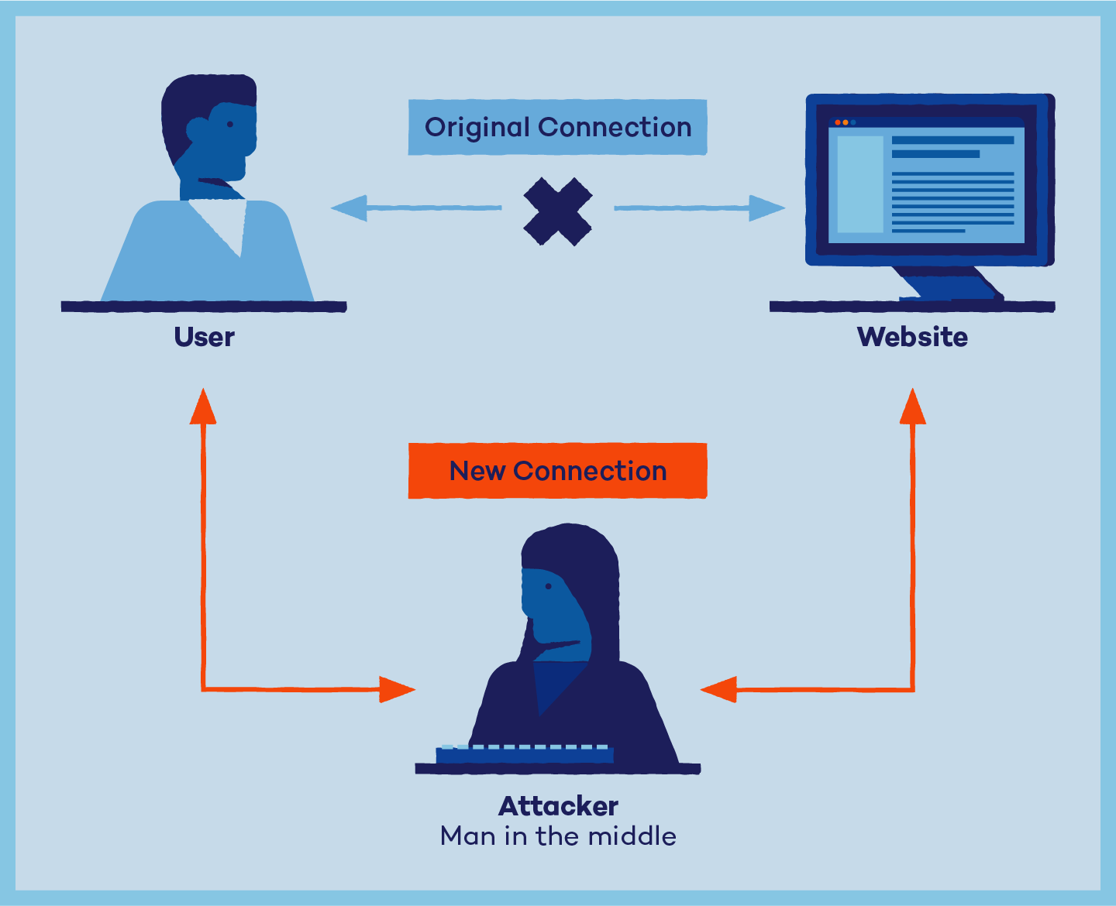
ICS Vulnerabilities
Man in the Middle Diagram
What Do Attacks Look Like?
The blue line, used to illustrate the connection between the client machine (endpoint user) and the website should occur as a simple communication between two points.
The orange line, used to illustrate the attack connection, shows how the connection between the user and the website has been intercepted, and now communicates in a path that goes from the user to the attacker to the website as well as reciprocally. This can be accomplished by use of web proxies, network sniffing, or dns tunneling.

Slide 12

ICS Vulnerabilities
Phishing Attack Website
What do Attacks Look Like? (cont.)
Website looks very similar to regular, legitimate website
The only real giveaway would be if you are knowledgeable about website construction and knew how Facebook domains should appear
In this example we can see that the .php extension is visible after the login domain, this is generally a trademark of a website that is new and hasn’t implemented hidden domains yet
We can also see that this login is using an api called skip. A quick google search reveals that Facebook doesn’t use skip and instead uses their own proprietary api

Slide 13
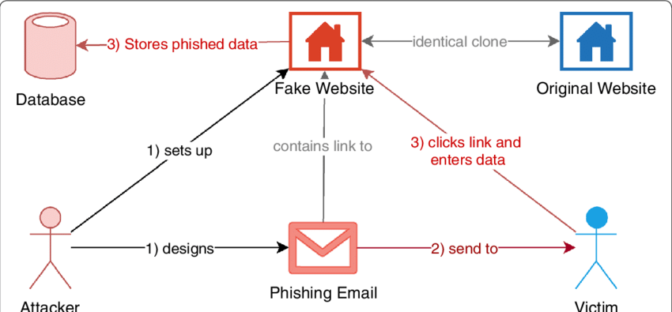
ICS Vulnerabilities
Phishing Attack Diagram
What do Attacks Look Like? (cont.)
This is a common type of phishing attack and involves some type of hook, generally some sort of hoax with an amount of credibility or relevance to end user’s life
This deals with a user getting sent a link and going to a phishing site, however DNS poisoning can also occur, causing the legitimate domain name to become poisoned with malware sending the endpoint user’s credentials back the the phishing attacker

Slide 14
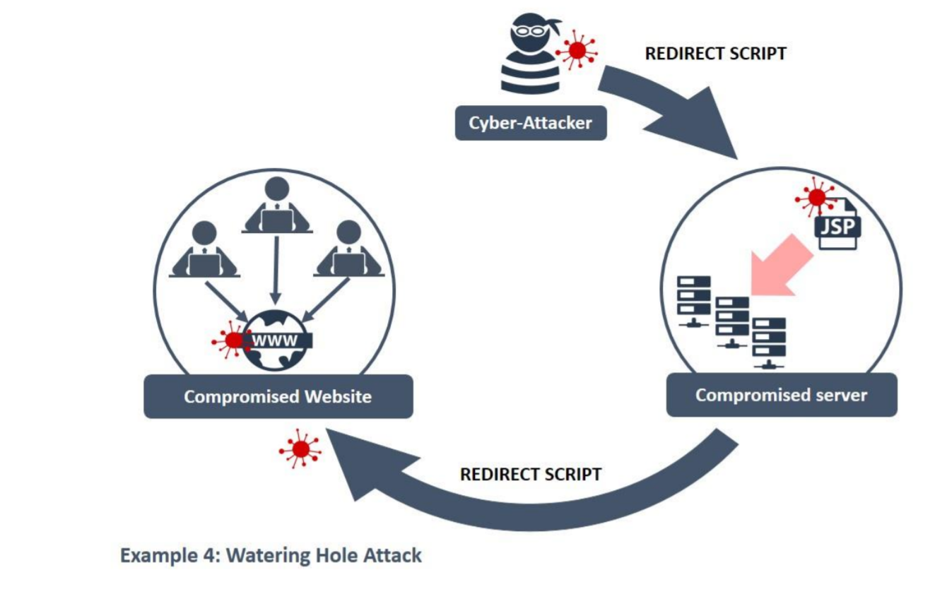
ICS Vulnerabilities
Watering Hole Attack Diagram
What do Attacks Look Like? (cont.)
A type of attack that infects the target web server with a script that redirects to a compromised website where user information or communication traffic can be monitored
This website redirect can also allow for an attacker to install some sort of script or program onto a endpoint client device, or it can even execute a piece of malware strictly within the system memory of the endpoint user

Slide 15
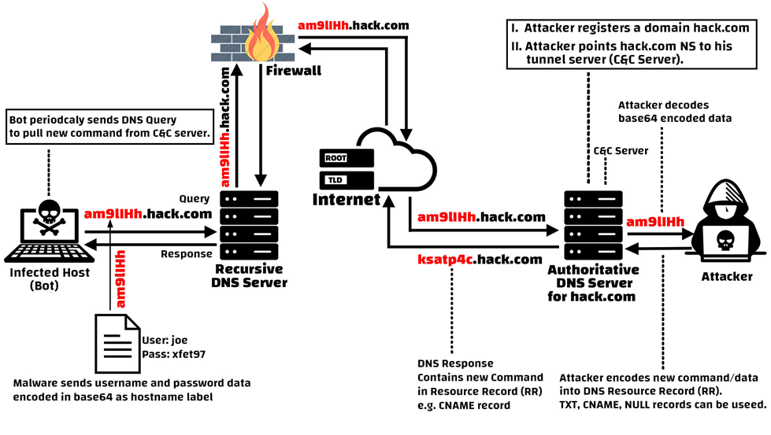
ICS Vulnerabilities
DNS Tunneling Attack
What do Attacks Look Like? (cont.)
Using a personal domain, an attacker can query a DNS server to repeatedly pull commands from it, this allows it to respond to the pull and put a new command into the server, this creates a recursive dialogue that is sent into the trusted DNS server
This allows a perpetual back door into a client’s system for the attacker, allowing them to gain a foothold on demand within the system

Slide 16
Section 3:
Securing Industrial Controls

Slide 17
Securing Industrial Controls
What is Standard Security Protocol?
Standardized and generalized practices that are used to ensure the protection of systems and data in the spheres of Informational and Operational Technology
Standard Security protocols have the advantage of being widely used and well understood, but they may lack for more specific applications where communications or data may need to be protected in spaces that aren’t occupied by the general person
Standard security protocols do have the disadvantage that with the implementation being public, it is much more likely for attackers to find exploits in the protocol, and that older, outdated versions of the protocol are significantly more likely to be penetrated due to known vulnerabilities
Some standard security protocol that you likely use daily are:
SSL/TLS
HTTPS
Kerberos
SET (Secure Electronic Transfer)
IMAP/POP3

Slide 18
Securing Industrial Systems
What are Proprietary Security Protocols?
Proprietary Security Protocols are methods that are purpose built by either the end user or a product manufacturer for use by the end user that pertain directly to either a device or a specific environment that needs to be secured.
PSPs often rely on obscurity, which is not a guaranteed safety mechanism. Being proprietary also means that you will never need to update your software, but it’s also always going to be more vulnerable if you don't.
Group14’s BAM 1 factory has devices from third-party vendors that run specific software and use security protocols that are specific to their respective vendors. For example, in our process devices from Onejoon we would need to obtain security directly from the company.

Slide 19
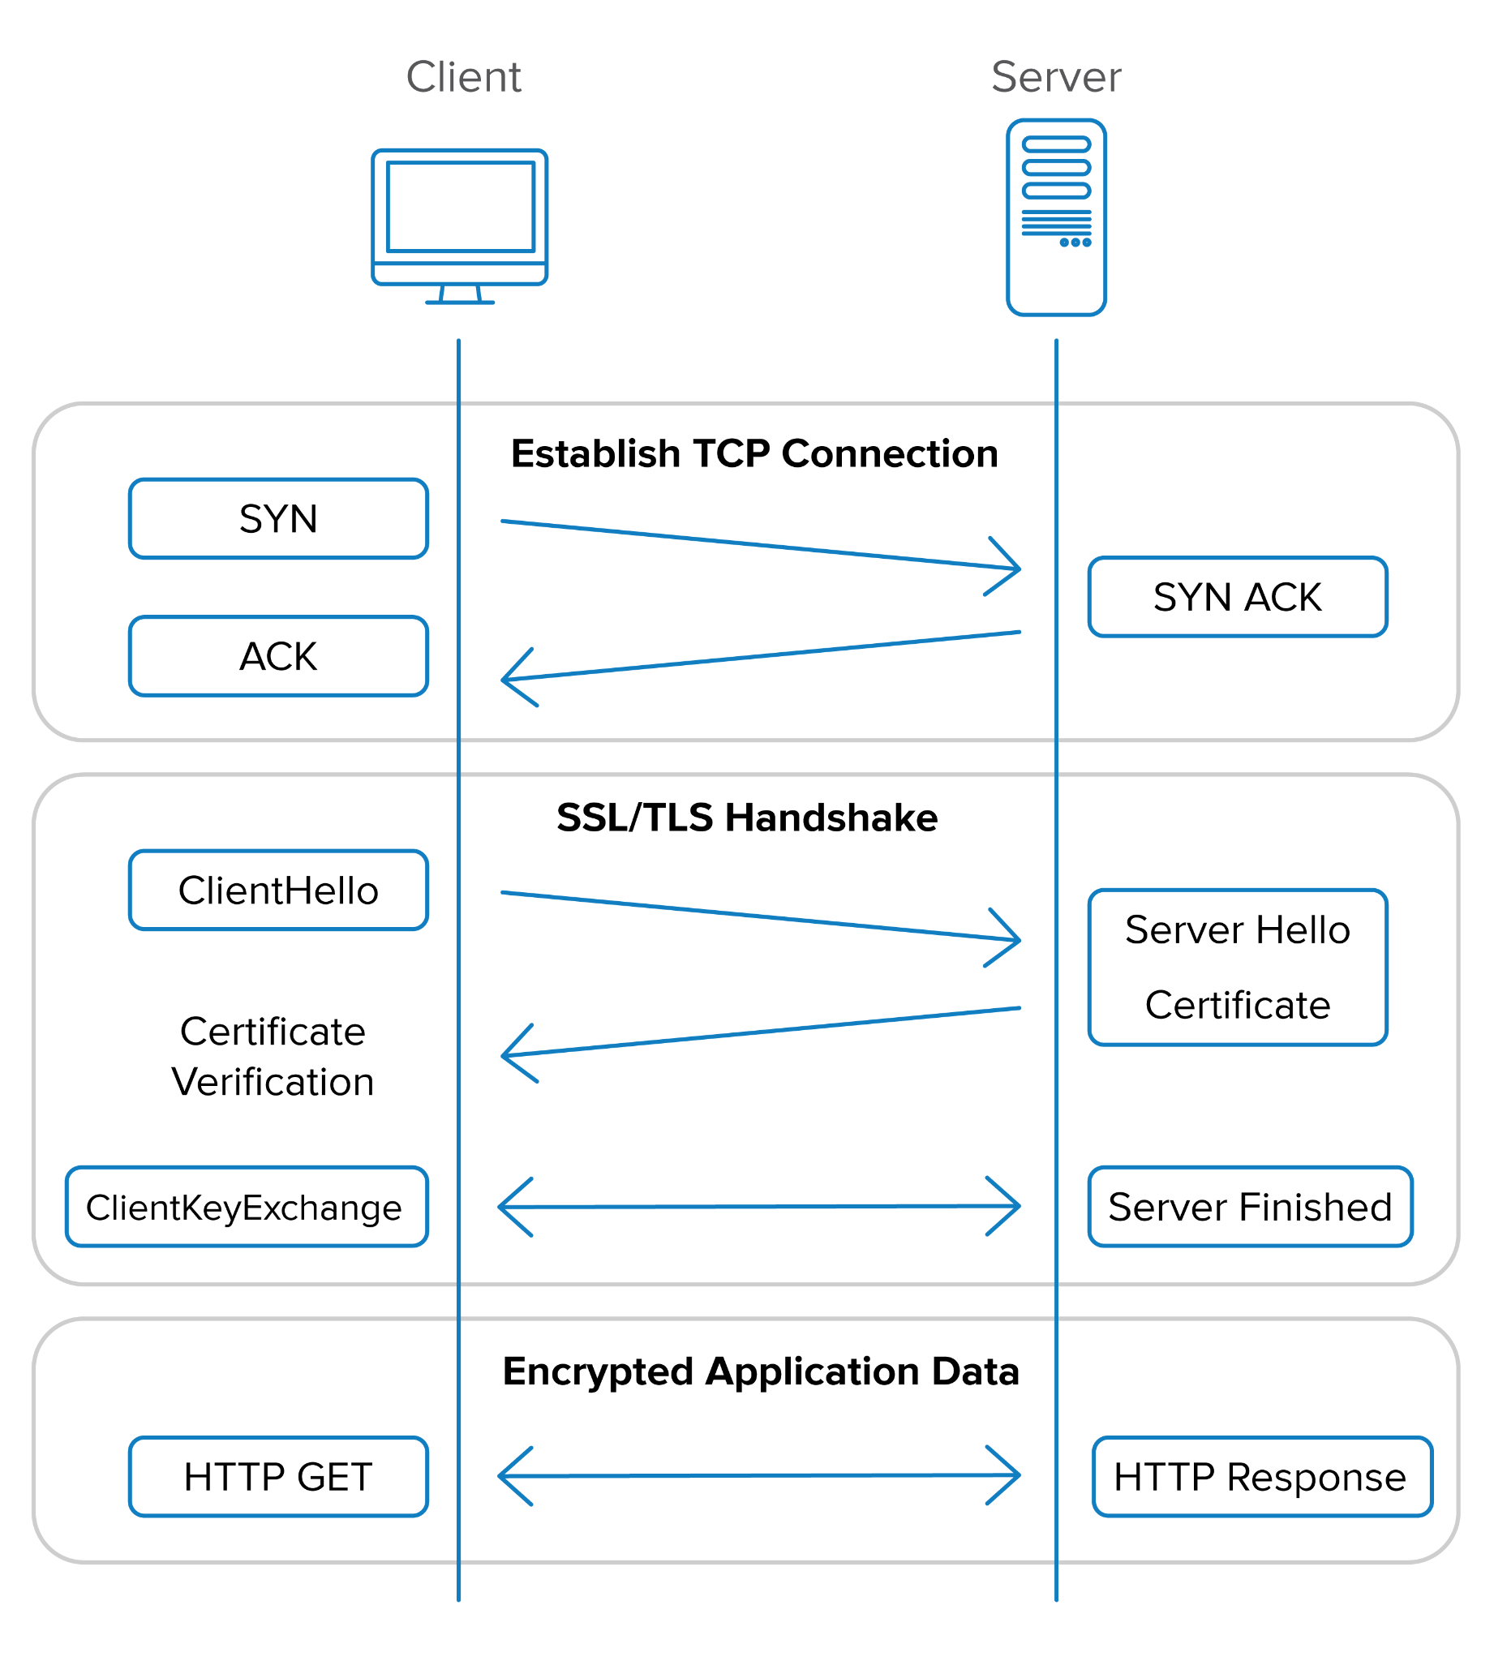
Securing Industrial Control Systems
TLS Certificate Encryption for Server Communication Sessions
What do Security Protocols Look Like?
Client sends signal to server to synchronize (SYN)
Server receives request, synchronizes, and then acknowledges client
Client acknowledges then says hello to server
Server says hello and sends the encryption cert to client
Client and server now establish a connection using the encryption certificate
To access the HTTP server’s data, a GET command is sent to the server and the server will only respond if the encryption is correct

Slide 20
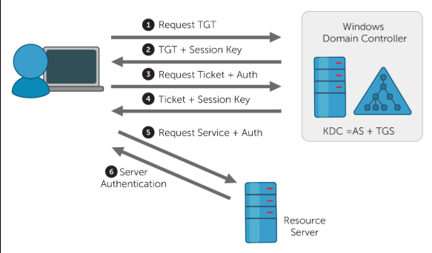
Securing Industrial Controls
Kerberos Security Protocol
What do Security Protocols Look Like? (cont.)
Client Machine Requests Ticket Granter access
Server sends authentication for client to access ticket granter
Client sends TGT to server and requests access ticket
Server sends client access ticket and session key
Client establishes communication with Kerberos enabled resource network to start session on server

Slide 21
Securing Industrial Controls
What Does ICS Security Look Like?
Like most disciplines of cybersecurity, Industrial Control System Security has a set of core axioms that security personnel should be aware of and follow to the best of their abilities, these axioms describe the goals of security work within the context of ICS and give good goalposts for security implementations.
These axioms are laid out in the following slides:
Restricting Logical Access to the ICS Network and Network Activity
Restricting Physical Access to the ICS Network and Devices
Protecting Individual ICS Components From Exploitation
Restricting Unauthorized Modification of Data
Detecting Security Events and Incidents
Maintaining Functionality During Adverse Conditions
System Restoration After Occurrence of Incident

Slide 22
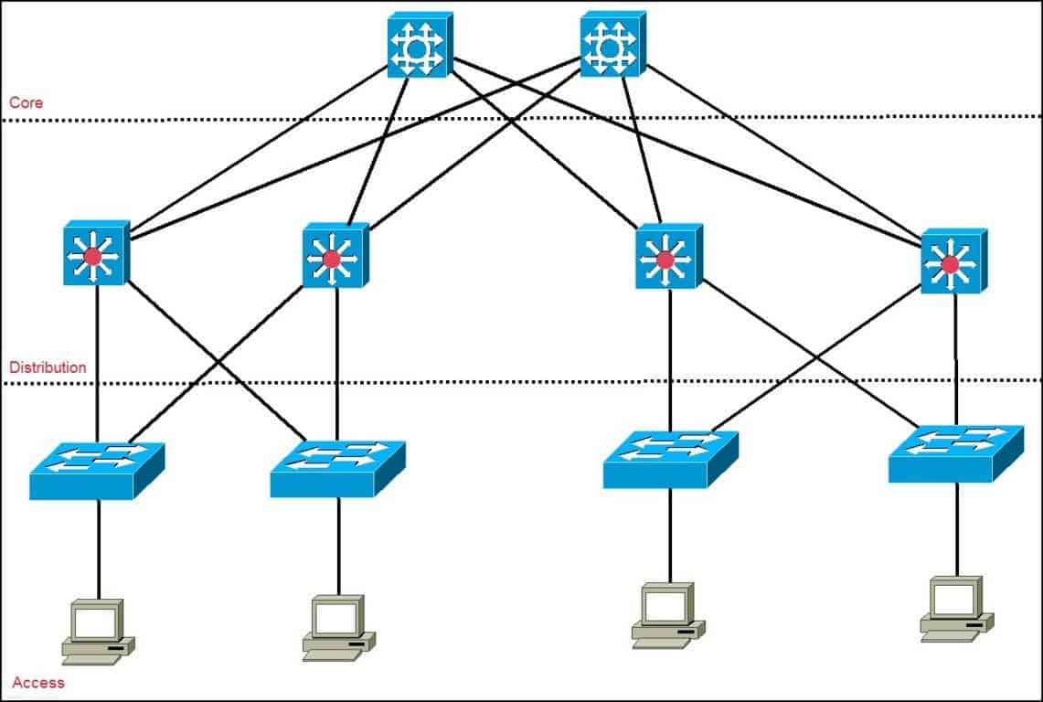
Securing Industrial Controls
Restricting Logical Access to Network and Network Activity
Restrictive access to the ICS network is essential to maintain the functionality of the ICS and safety of the operational personnel.
These restrictions can come in many forms, some are as follows:
Unidirectional Traffic Gateways
Demilitarized Zone Inclusion in Network Architecture
This prevents traffic from flowing between corporate and ICS networks
Multiple Layer Network Architecture
Hierarchical design of Network Architecture means that if one part of the network is accessed, that the entire network is inaccessible without the proper authentications, making the job of system penetration significantly more difficult.
Notes:
You may notice that this in this specific wording, access is preceded by the word logical; logically you will want no outside, unauthorized entity to have access to the sensitive network, but some wireless communication for authorized key holders may be desirable, especially in scenarios where remote access is needed, or a centralized RTU is desired.

Slide 23
Securing Industrial Controls
Restricting Physical Access to ICS Network and Devices
Perhaps one of the simplest high-level goals to achieve, this axiom is fairly self explanatory; implementing basic security protocols to prevent site access of individuals to the physical control units or process enablers increases security for the entire system.
We also need to consider the danger of giving authorized visitors to the site access to our network, both corporate or otherwise, as they could easily come in with a way to listen to the network traffic, hide nefarious software or scripts inside of the network after authentication, and many other things that are undesirable.
Solution: Physically restricting access to these devices from areas that are accessible to campus visitors.

Slide 24
Securing Industrial Controls
Protecting Individual ICS Components From Exploitation
The need to secure individual components, especially those components that could cause critical failure or serious safety concerns in the system, is highly important to maintain the highest levels of efficiency and safety within a facility.
The security of these components may manifest itself in unique ways, or it may be similar across components.
Solution: Maintain a detailed log of all potential security incidences, and an inventory of the tools to handle these types of compromising events.

Slide 25
Securing Industrial Controls
Restricting Unauthorized Modification of Data
Resting vs Transit Data
Resting data: Stored, static data
Transit data: Active, communicated data
Both types of data are important to secure for differing reasons, but the modification or surveillance can carry heavy impact on an organization.
Solution: Securing communication and authentication protocols and keeping our systems up to date.
Notes:
For resting data, the risk that we run if it is unsecured is that some piece of sensitive data is changed or logged, meaning that attackers may be able to either disrupt production due to an error in the standardized operating protocols, or may be able to sell the data that they have acquired to competitors or other third parties
Securing resting data can occur in many different ways; this may include restricting access via authentication protocols, encryption, or even physical storage of this data on localized machines not connected to a network.
Transit data modification also causes many of the same risks, but in different ways than resting data. For example, if an attacker takes advantage of an unsecure service running on a network port, or were to insert themselves in the middle of communication between a client machine and the desired network, they may be able to gain access to sensitive data being communicated or gain the ability to otherwise compromise the system
Securing transit data involves the implementation of communication protocols, network filtering, and authenticated user access

Slide 26
Securing Industrial Controls
Detecting Security Events and Incidents
The singularly most important thing to accomplish when securing an ICS is the ability to detect compromising events within your system.
Detection of threats to your security allows the team in charge of security to anticipate attacks, and to completely avoid them in the future. The preventative maintenance of your system to outside threats is significantly more impactful to production and safety than the regressive, restorative maintenance that occurs after an attack.
Solution: Maintain monitoring services and a verbose log of security incidents.
Notes:
This allows the security personnel to do a few things; detection allows the team to evaluate and respond to these incidences immediately, plan for future occurrences of this same event, and implement monitoring and preventative protocols in regards the event detected.
It is also prudent to keep in mind that these logs will serve as your informational backbone to securing your system, and should be as verbose and informative as possible; they should include responses to the event, any restorative maintenance required due to the event, and mitigation protocols for similar events in the future.

Slide 27
Securing Industrial Controls
Maintaining Functionality in Adverse Conditions
Due to the likelihood of interference in every ICS, it is important that security personnel are able to mitigate the system response to these adverse conditions and maintain process functionality under these circumstances.
This involves maintaining and constructing an ICS with built in systematic redundancies, so that if one part of the system were to fail, another part of the system can take over the responsibilities of that component, preventing unnecessary traffic on the ICS network or a cascading failure throughout the rest of the system.
Accounting for these adverse conditions also means that the ICS should be designed in a way that allows gradual degradation, meaning that it can move from the standard process, to an emergency process requiring more operators and less automation, to a completely manual process requiring no automation whatsoever.
Solution: Standardizing incident response protocols.

Slide 28
Securing Industrial Controls
System Restoration After Occurrence of Incident
Simply due to the nature of ICS, it is statistically inevitable that an incident that disrupts the process in some way or another will occur at some point during operation; this axiom deals with not only the standardization of response to this event, but also the actions that need to be taken after the event occurs to restore proper safety and process environments.
It should become a goal for both the engineering team and the security team to collaboratively build a system that allows for the quickest relapse from incidents disrupting the process while maintaining the highest level of security and diligence required. Systematization, compartmentalization, and standardization of these protocols, as well as regular reinforcement of an individual’s job and responsibilities during these incidences is the most effective way to achieve this quick restorative process.
Solution: Standardizing system failure protocols.
Notes:
It should be noted that any time a change is needed in the process, that it should be communicated and approved by all parties holding essential or relative roles within the protocol. Communication of these changes is essential for maintaining safety and efficiency during incident responses and incident response trainings.

Slide 29
Section 4:
Local Implementation

Slide 30
Local Implementation
What Needs to Be Done?
When developing a security implementation plan for a company, several things need to occur to make sure that your implementation will be successful and receive the approval that is needed.
The basic process is as follows:
Develop a Business Case for Management
Build and Train a Cross-Functional Team (An IT employee, a process engineer, a security employee, a risk management employee)
Define Charter and Scope
Define Specific ICS Policies and Procedures
Implement an ICS Security Risk Management Framework
Define and Inventory ICS Assets
Develop Security Plan for ICS Systems
Perform a Risk Assessment
Define the Mitigation Controls
Provide Training and Raise Awareness of ICS Staff
Provide Training and Raise Awareness of Non-ICS Staff

Slide 31
Local Implementation
Business Plan for Security at Group14
How does the implementation of security protocols at headquarters benefit Group14 as a whole?
Implementation improves control system reliability, availability, safety, and resiliency. Securing the process control system here allows us to systematically control and mitigate potential disruptions while also providing us with response framework to help aid in the restoration of normal operations.
Providing improved and standardized safety implementations helps to boost morale, health, and employee retention
It reduces the concerns of third parties, including the community and investors, that a critical failure could cause environmental impact or majorly damage production efficiency
Reduces the likelihood of legal liabilities, as having a system that is not only more safe, but operates and stores, communicates, and collects data more securely allows for a smaller error radius than an unsecured system
Increasing security of controls allows for the regulatory requirements surrounding system updates, changes, and maintenance to be met more efficiently and with greater ease

Slide 32
Local Implementation
Business Plan for Security at Group14 (cont.)
How does the implementation of security protocols at headquarters benefit Group14 as a whole? (cont.)
Increase and standardization of security protocols reduces the amount of system failures and production delays, increasing the image and reputation of Group14 as a company that is reliable and able to deliver
Risk analysis allows Group14 to weigh the costs and benefits of new process control design and allows a more informed decision to be made on protective actions and preventative measures
Standardization and implementation of security protocols allows Group14 to reduce the costs of insurance related expenses as it decreases the likelihood of damages to occur
Security implementation can help to increase the relationship between Group14, investors, and banking institutions as giving a promise of increased security creates a sense of increased reliability and lowers the perceived financial risk of investment in the company

Slide 33
Local Implementation
Business Plan for Security at Group14 (cont.)
What are some of the potential consequences if a security breach occurs without standard response procedures?
Physical Impact to Process
Personal Injury or Loss of Life
Irreparable damage to equipment
Loss of Property (Data, Facilities, Equipment)
Environmental Damage
Physical Impact to Process
Economic Impact
Second Order Effects from Physical Impacts
Loss of process functionality could reduce production volume or permanently decrease the amount of yield and strain that the process can handle
Negatively impacting our investors; loss of funding on our end
Social Impact
Failures negatively impact reputation, and perceived reliability to companies
Loss of funding from investors due to failure to deliver
Loss of national or public confidence

Slide 34
Local Implementation
Business Plan for Security at Group14 (cont.)
How do we address and analyze risks that could impact Group14?
Tier I : Organization
This concerns what happens internally within an organization
Managed and analyzed by cross-trained security team
What could go wrong at this organization and how would we respond to it?
Performs preventative security internally
Tier II : Mission/Business Processes
Managed by business team and legal team
Concerned with the risk of performing business with third parties
What could go wrong with relations or transactions with third parties?
Performs legal responsibilities and is responsible for liability management of the organization
Tier III : Information Systems
Deals with diffusion of company information including production information, product information, release schedules, and historical data
Concerned with the social and economic risks of releasing information on the organization
Also deals with information that the company has stored locally and that is considered proprietary or otherwise sensitive or confidential

